Slide 1
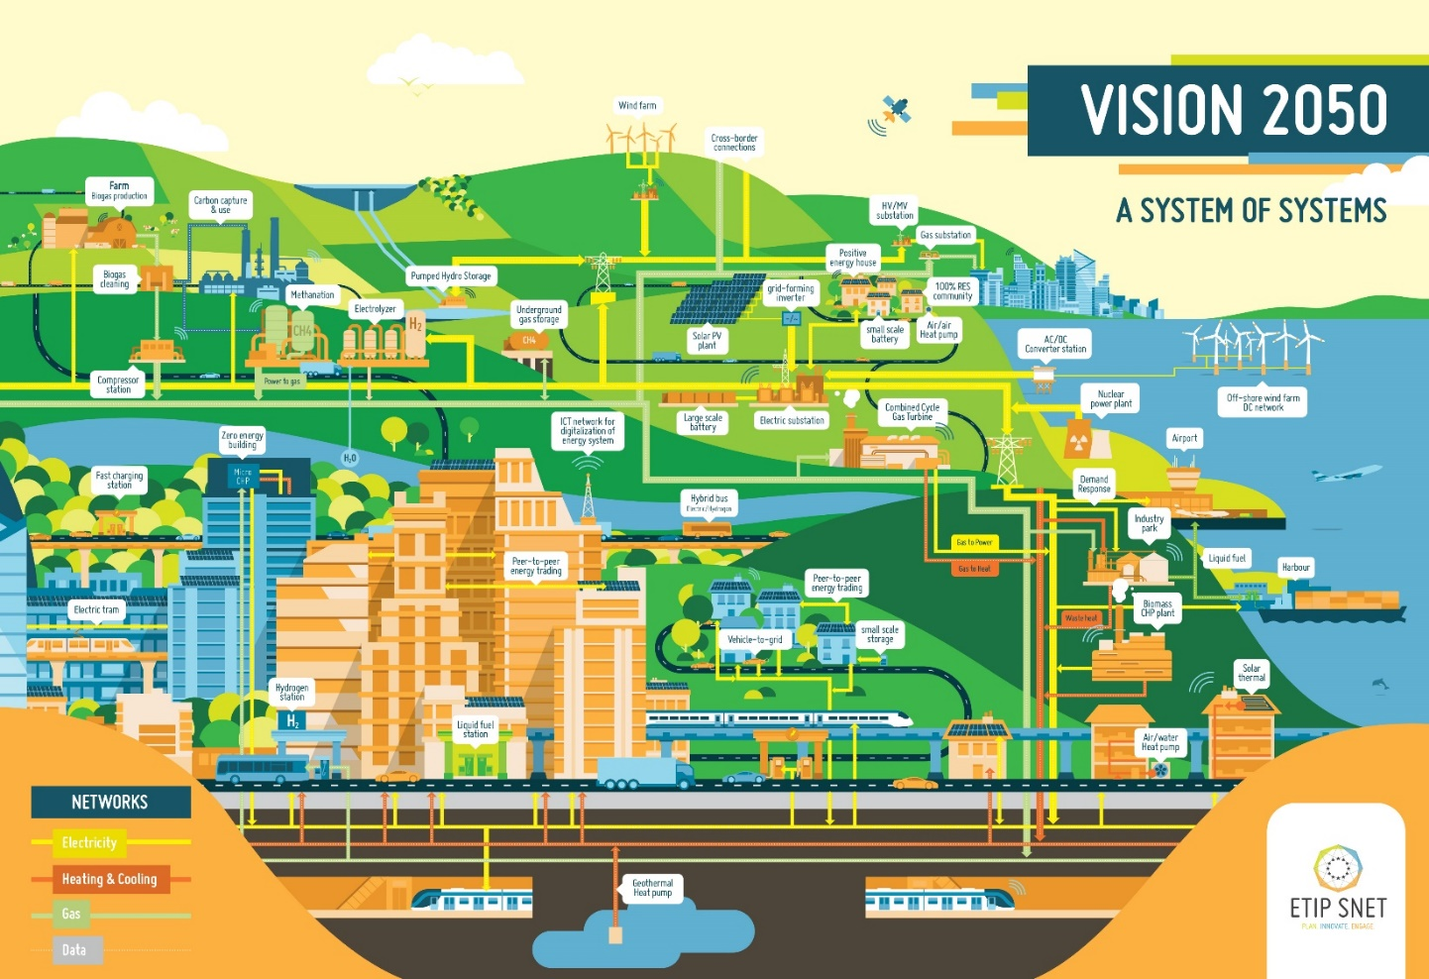
ETIP SNET: The 2050 Vision of Europe’s Energy System
An energy system (almost) fully decarbonised
A system of systems (combining gas, heat & electricity grids)
Power conversion and flexible energy storage
Seasonal storage in the form of gas, liquids or other non-battery massive storage
Low-cost, efficient balance of thermal energy supply and demand
In 2050, thermal power generation, mainly running with renewable energy sources (concentrated solar power, biomass, biogas, synthetic gas such as methane and hydrogen, and geothermal) provides flexibility (including at partial loads) while guaranteeing electricity and heat supply during (winter) times with limited or less renewable energy supply.

