Slide 1

Brief introduction to the activities of the ETIP-DG
Fausto Batini – President ETIP-DG
Co-funded by the European Union's Horizon 2020 Research and Innovation Programme [GA. N. 773392]

Slide 2
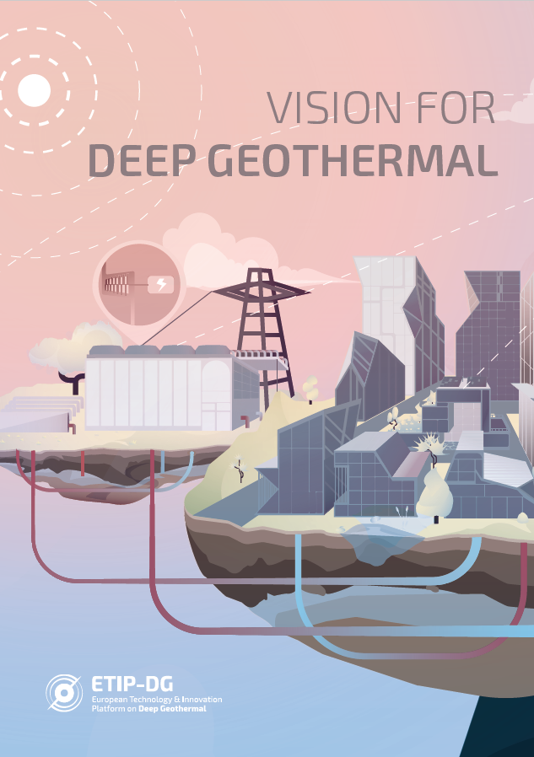
ETIP-Deep Geothermal
MISSION
Promotion of the research and innovation in the Deep Geothermal sector to contribute to the City of the Future, where a combination of renewable energy sources are integrated into the system.
OBJECTIVES
Implementation of the Strategic Research Agenda (SRA) to enable the geothermal technologies to :
unlock new geothermal resources as an affordable, sustainable and secure energy source in large areas of European countries
achieve a significant reduction of the development and O&M costs of the geothermal projects by improving the performance of technologies and developing new concepts and processes for energy conversion
increase the social acceptance of the geothermal energy, improving the quality of life of the local Community
maintain and even strengthen the European leadership in geothermal industry sector continuing to export know-how and technologies worldwide.

Slide 3
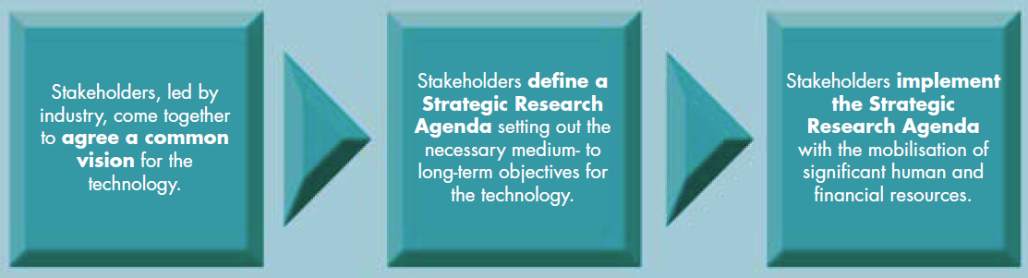
ETIP-DG Strategic Research Agenda
3

Slide 4
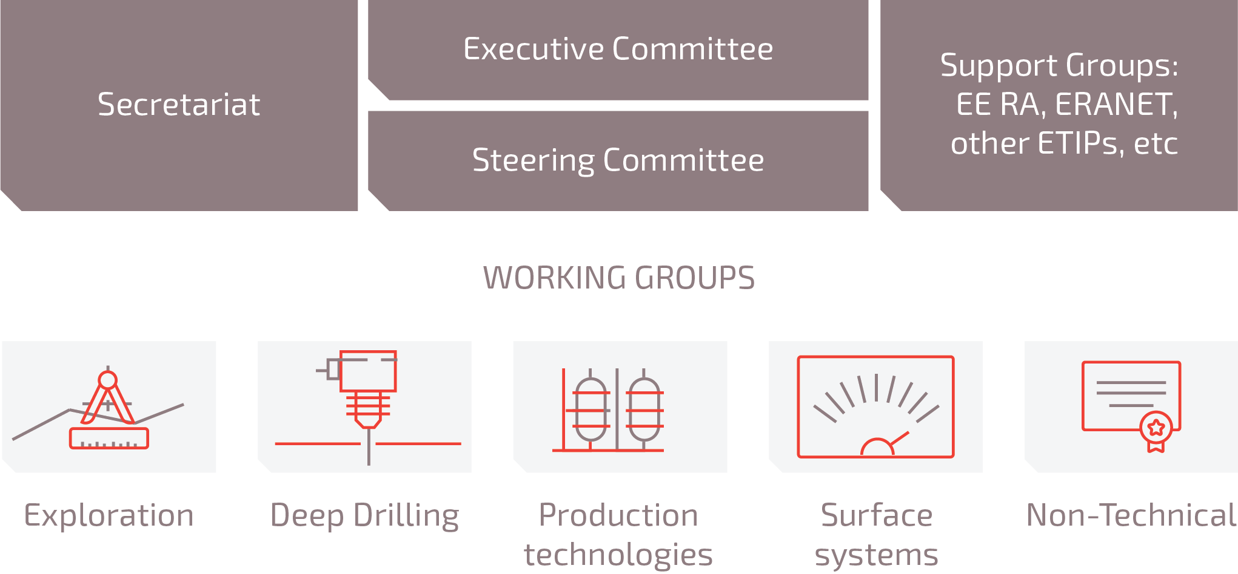
ETIP_DG Roadmap
WORKING GROUP
MAIN STEPS
Phase 1 (January 2019 - March 2019)
  Collect data and discuss RD&I priorities for the relevant theme of the WG, taking the SRA as a basis.
Phase 2 (March 2019 - April 2019)
  SC prepare a list of topics to be included in the Roadmap. Questionnaire
Phase 3 (May-June 2019).
  Validation of the Roadmap during an open consultation process and publication.

Slide 5
Communication
Events:
Workshop on SET-Plan Operation: Implementation Plans & Working Groups, in Bucharest, 11th of June 2019
ETIP_DG Annual assembly 2019 : from 16h30 to 18h00 on 13/06 in The Hague (after EGC2019)
Risk Workshop in Postdam (Germany): 28/05
EUSEW 2019 in Brussels:
Policy session: 18/06, 14h00-15h30
Workshops with Regions: 19/06, 9h-13h

Slide 6
The sole responsibility of this publication lies with the author. The European Union is not responsible for any use that may be made of the information contained therein. This project has received funding from the European Union's Horizon 2020 research and innovation programme under grant agreement No [773392 — DG ETIP]

Slide 7
Research strategy
Data sharing platform > now called EGRISE
European Geothermal Research & Innovation Search Engine
Vision of Deep Geothermal RD&I – December 2017
Strategic Research Agenda of Deep Geothermal RD&I (February 2019)
Roadmap of Deep Geothermal RD&I (June 2019)

Slide 8
RD&I framework
Position papers, recommendations and strategy papers (ongoing)
- Coal regions in Transition > new Energy Transition Fund
- Inputs to the NECPS 2020-2030 (National Energy & Climate Plan)
Factsheets to present financial instruments for deep geothermal demonstration projects (May 2019)
Report on competitiveness of the geothermal industry (June 2019)

