Slide 1
Chapter RESOURCE ACCESS AND DEVELOPMENT
Webinar consultation 24/05/2019

Slide 2
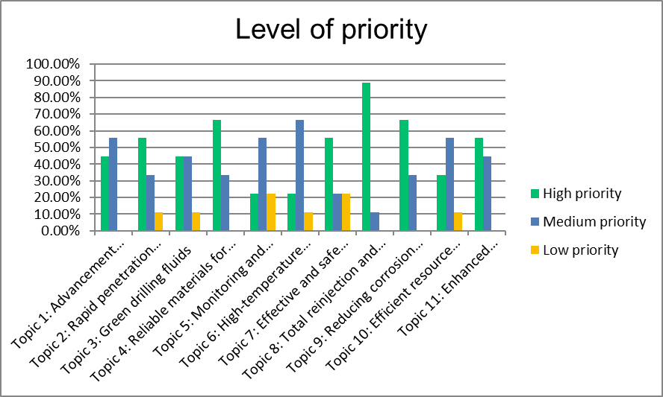
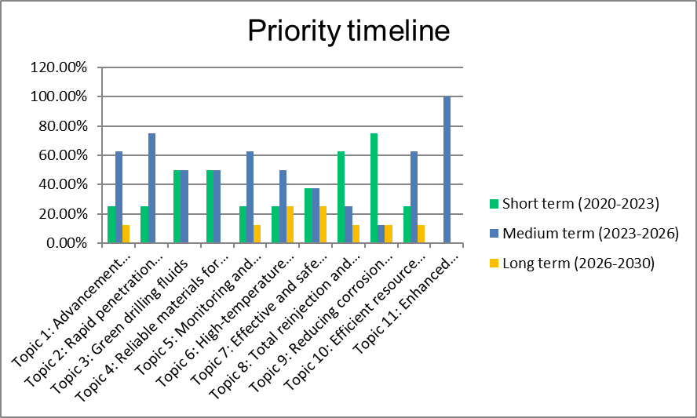
Steering Committee assessment
Topic 1: Advancement towards robot drilling technologies
Topic 2: Rapid penetration rate technologies
Topic 3: Green drilling fluids
Topic 4: Reliable materials for casing and cementing
Topic 5: Monitoring and logging while drilling (incl. ‘looking ahead’ of the bit)
Topic 6: High-temperature electronics for geothermal wells
Topic 7: Effective and safe technologies for enhancing energy extraction
Topic 8: Total reinjection and greener power plants
Topic 9: Reducing corrosion and scaling and optimising equipment and component lifetime
Topic 10: Efficient resource development
Topic 11: Enhanced production pumps

Slide 3
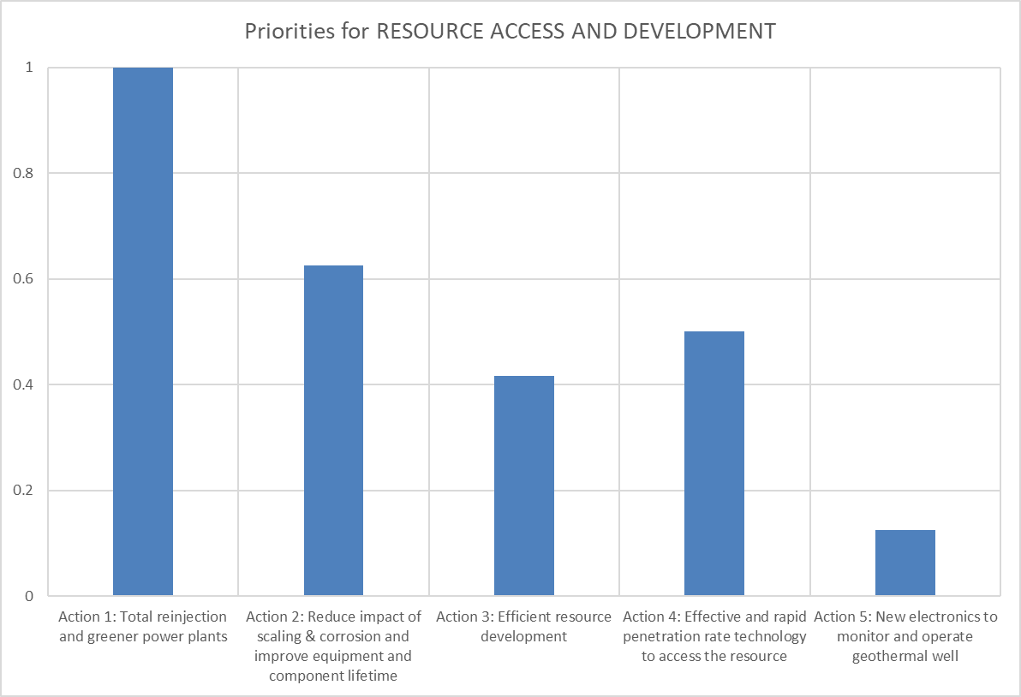
Steering Committee assessment – grouping of the topics
Topic 8 -> Action 1: Total reinjection and greener power plants
Topic 4 & 9 & 3 -> Action 2: Reduce impact of scaling & corrosion and improve equipment and component lifetime
Topic 7, 10 & 11 -> Action 3: Efficient resource development
Topic 1 & 2 -> Action 4: Effective and rapid penetration rate technology to access the resource
Topic 6 -> Action 5: New electronics to monitor and operate geothermal well

Slide 4
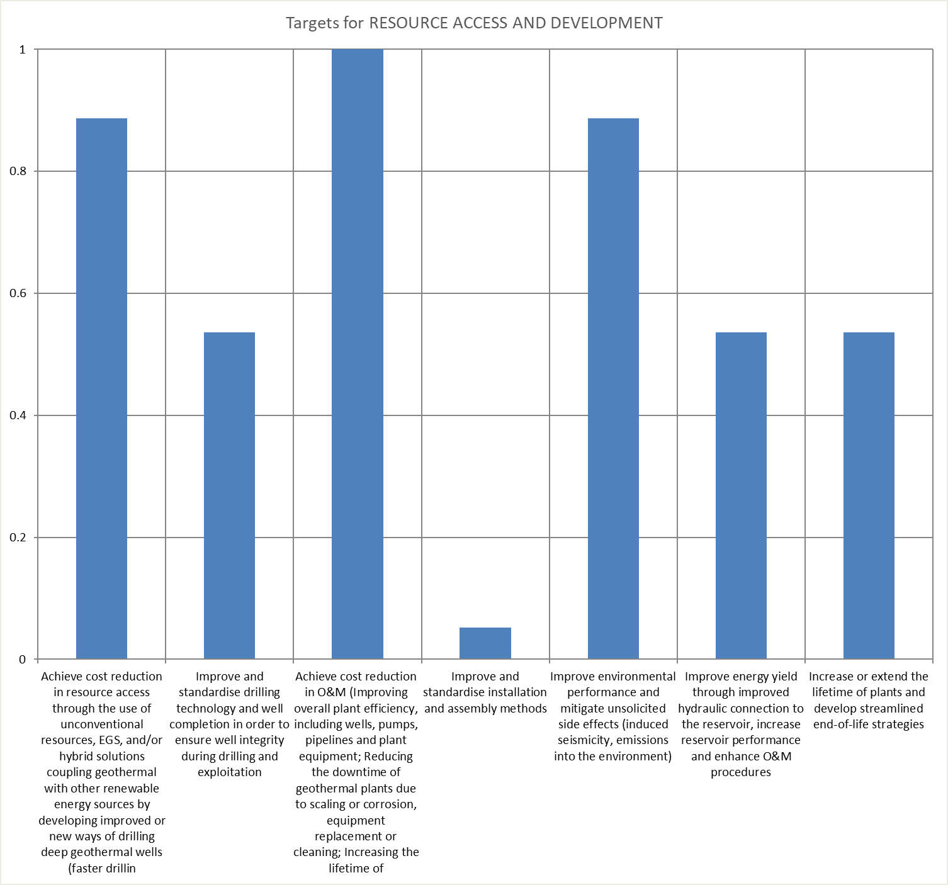
Steering Committee assessment – priority targets
Achieve cost reduction in resource access through the use of unconventional resources, EGS hybrid solutions coupling geothermal with other renewable energy sources by developing improved or new ways of drilling deep geothermal wells and data analysis
Improve and standardise drilling technology and well completion in order to ensure well integrity during drilling and exploitation
Achieve cost reduction in O&M (Improving overall plant efficiency, including wells, pumps, pipelines and plant equipment; Reducing the downtime of geothermal plants due to scaling or corrosion, equipment replacement or cleaning; Increasing the lifetime of components and equipment)
Improve and standardise installation and assembly methods
Improve environmental performance and mitigate unsolicited side effects (induced seismicity, emissions into the environment)
Improve energy yield through improved hydraulic connection to the reservoir, increase reservoir performance and enhance O&M procedures
Increase or extend the lifetime of plants and develop streamlined end-of-life strategies

Slide 5
Action 1: Total reinjection and greener power plants
Objectives
  Development of reliable, safe and cost-efficient technologies to improve the environmental performance of geothermal power systems over their entire lifecycle. This objective can be reached by reinjection of the geothermal fluid including non-condensable gasses (NGCs) or by development of technology for the capture, sustainable use or abatement NCGs through:
    The development of coupled well-reservoir multiphase flow models to understand and predict the chemical and physical behavior of geothermal fluids and geo-mechanical behavior of reservoir rocks
    The development of technology for the capture, sustainable use, abatement or reinjection of NCGs (from TRL4 to 7 now to TRL 7 to 9 by 2023 and market uptake by 2026)

Slide 6
Action 1: Total reinjection and greener power plants
Targets
  Reduction of geothermal emissions by xx% in 2026
Priority: high
Timeline: short
Scope
  Technology development including lab testing and demonstration in relevant environments in the period 2020 – 2023
  Demonstration in at least 3 geothermal areas by 2026

Slide 7
Action 2: Reduce impact of scaling & corrosion and improve equipment and component lifetime
Objectives
  Development of effective and environmentally benign measures to control scaling and corrosion (TRL 6 – 8 by 2023, TRL 9 by 2026)
  Development of save and environmentally benign measures to remove scaling (TRL 6 – 7 by 2023, TRL 8 – 9 by 2026)
  Development of materials that are resistant to corrosion and/or have anti-scaling properties. Such materials can help to reduce operational costs and downtime and to increase the lifetime of components such as submersible pumps and tubing (TRL 5 – 7 by 2023, TRL 8 – 9 by 2026)
  Developing materials, including casing couplings and cements, to improve overall heat transfer and to guarantee integrity and resistance to fatigue over the well’s lifetime under the challenging conditions encountered in geothermal applications (TRL 5 – 6 by 2023, TRL 7 – 8 by 2026, TRL 8 – 9 by 2030)
  Development of eco-friendly drilling fluids that are stable under high temperature – high pressure conditions and that effectively protect drilling equipment against corrosion (TRL 4 – 5 by 2023, TRL 6 – 7 by 2026, TRL 8 – 9 by 2030)

Slide 8
Action 2: Reduce impact of scaling & corrosion and improve equipment and component lifetime
Targets
  Reduce O&M costs per MWh produced with xx% in 2030 by:
    Reduced downtime of geothermal plants due to scaling or corrosion, equipment replacement or cleaning
    Increased lifetime of components and equipment
    Improve environmental performance and mitigate unsolicited side effects
Priority: moderate to high
Timeline: short to medium
Scope
  technology development and demonstration

Slide 9
Action 3: Efficient resource development
Objectives
  The development of effective and safe technologies for enhancing energy extraction from low permeability rock (TRL 5 – 6 by 2023, TRL 7 – 8 by 2026, TRL 9 by 2030)
  Development of second generation geothermal pumps with prolonged lifetime under aggressive fluid conditions or of alternative lifting technologies (TRL 6 – 7 by 2023, TRL 8 – 9 by 2026)
  Increase the ability to predict the thermal, flow and operational behavior of geothermal reservoir, well field and steam network in order to enhance the capacity to control and predict the management efficiency of a geothermal power plant. This asks for the development and testing of thermodynamic models coupled to the flow of steam as well as model to evaluate flow of mass and heat in geothermal wells and reservoirs

Slide 10
Action 3: Efficient resource development
Targets
  Improve energy yield through improved hydraulic connection to the reservoir, increased reservoir performance and enhanced O&M procedures by 20% in 2026 and 30% in 2030
  Increase the lifetime of geothermal pumps for geothermal resources up to 140°C to at least 5 years in 2026 and at least 10 years in 2030
  Lift the operational window of pumps / lifting technologies to 200°C – 80 l/s – 1000 m lift by 2026 and 250°C – xx l/s – xx m lift in 2030
  Extend the lifetime of plants
Priority: moderate
Timeline: short to medium
Scope
  Research on mass and thermal flow modelling (2020 – 2026)
  Technology development, testing and validation (2020 – 2026)
  At least 3 demonstration projects of enhanced heat extraction from low permeability by 2030

Slide 11
Action 4: Effective and rapid penetration rate technology to access the resource
Objectives
  Development of proven or new rock destruction mechanisms into highly efficient and versatile rock destruction processes for geothermal applications
  Elaboration of protocols and tools to ensure wellbore stability and to avoid lost-in-hole accidents
Targets: Achieve cost reduction in resource access by:
  Reducing the time needed to complete a well by 25% in 2026 and 50% in 2030
  Reducing delays due to wellbore stability issues by xx% 2026 and xx% in 2030
  Reducing costs due to lost-in-hole accidents by xx% 2026 and xx% in 2030
Priority: moderate
Timeline: medium
Scope
  Technology development and demonstration
  knowledge exchange among geothermal operators / drillers as well as between the geothermal industry, oil & gas and the mining industry (2020 – 2030)

Slide 12
Action 5: New electronics to monitor and operate geothermal well
Objectives
  Develop electronics and sensors to be used in high-temperature geothermal wells during drilling operations. This will lead to better control of the drilling process reducing the risk of wellbore stability and to lost-in-hole accidents
  Development of data communication technologies that allow fast and reliable data transfer under high-temperature conditions
Targets
  Development of electronics and sensors that can withstand temperatures of 350°C in 2030
  Development of data communication technologies that can withstand temperature up to 350°C in 2030
Priority: low
Timeline: medium to long
Scope
  Technology development and demonstration
  This action is related to action 4 and asks for collaboration with the ICT industry (see D5.3: External stakeholders, common RD&I needs and complementary actions)

Slide 13

The sole responsibility of this publication lies with the author. The European Union is not responsible for any use that may be made of the information contained therein. This project has received funding from the European Union's Horizon 2020 research and innovation programme under grant agreement No [773392 — DG ETIP]

