Slide 1
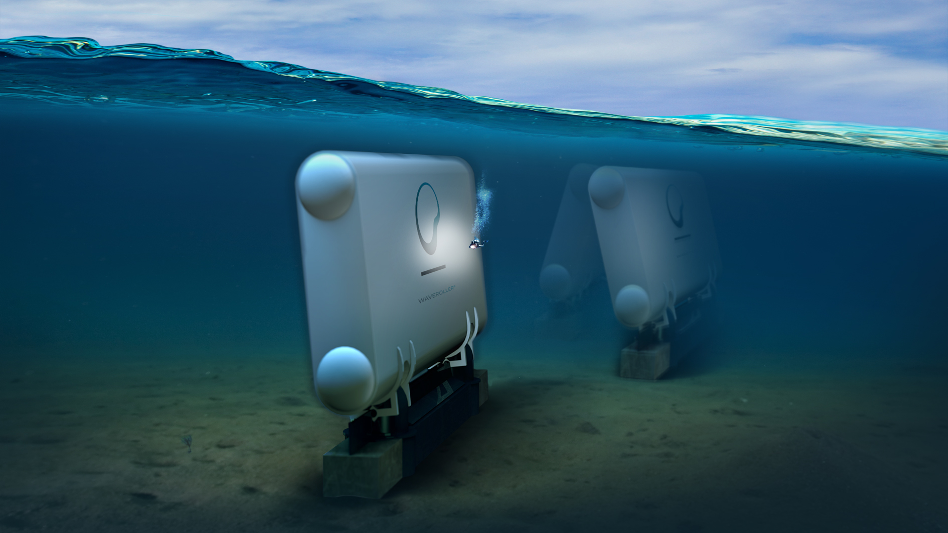
Ocean energy : a valuable source of flexibility
Donagh Cagney, Policy Director, Ocean Energy Europe

Slide 2
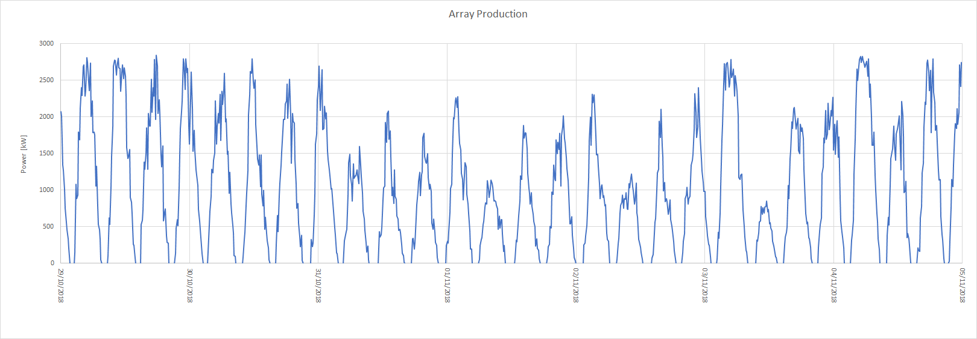
Tidal energy: 100% predictable
MeyGen Tidal Array: 1 Week of Production

