Slide 1
Deep geothermal energy at Mol: The Balmatt-project
FlexiRes, Januray 10th, 2019
Johan Van Bael – Project Manager – Activity leader Thermal Energy Storage and Conversion Systems

Slide 2
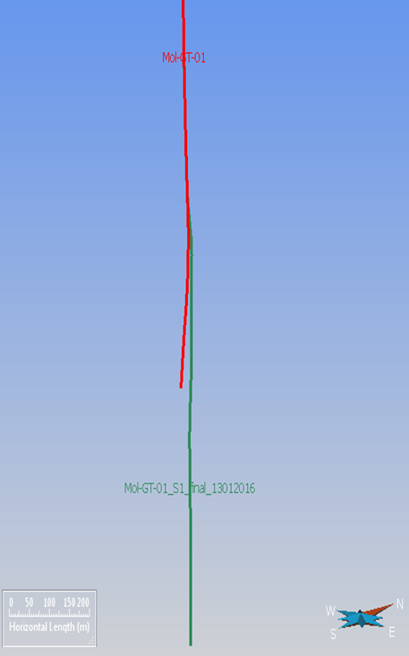
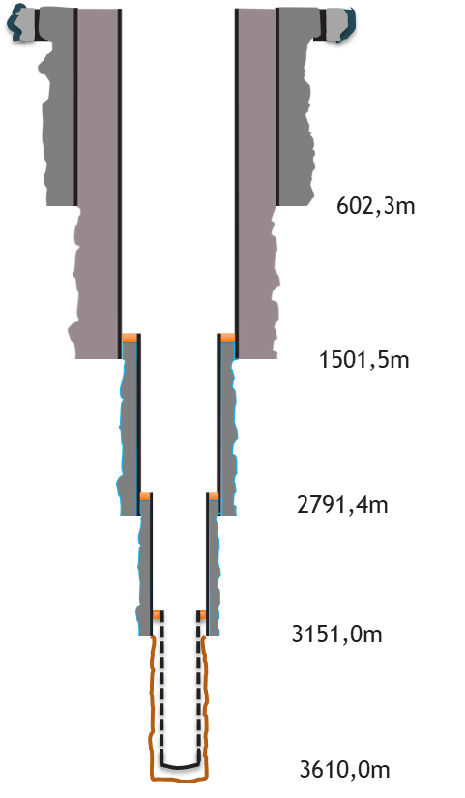
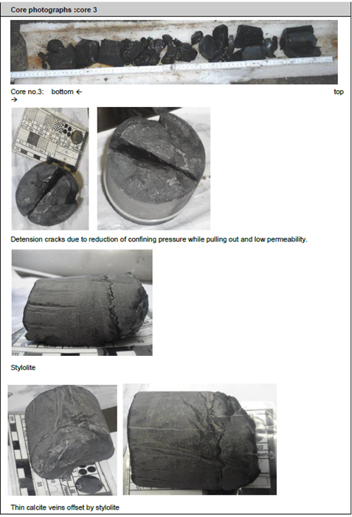
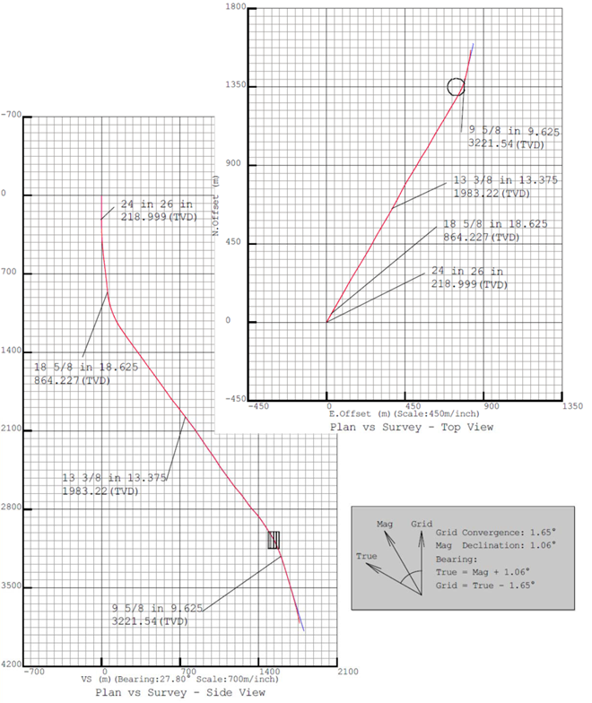
Drilling
The Balmatt-project
MOL-GT-02
Start: March 2016
End: August 2016
Final TD: -3805m TAW (4341m MD)
BHT: 142°C
MOL-GT-01(-S1)
Start: September 2015
End: January 2016
Final TD: - 3583m TAW (3610m MD)
BHT: 138°C

Slide 3
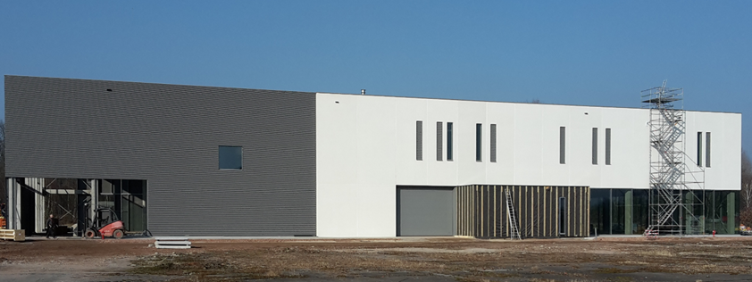
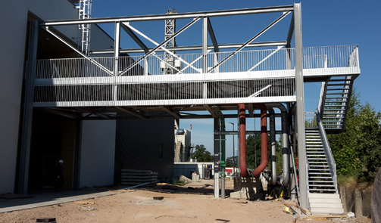
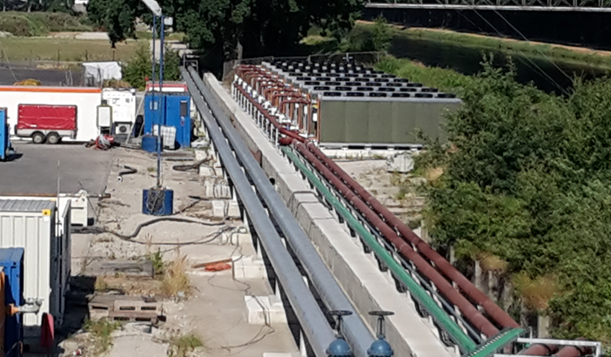
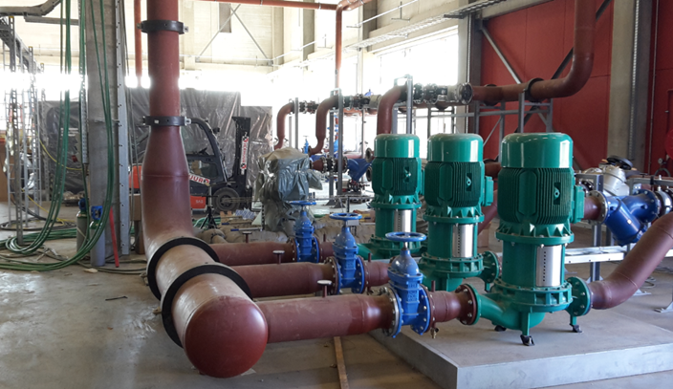
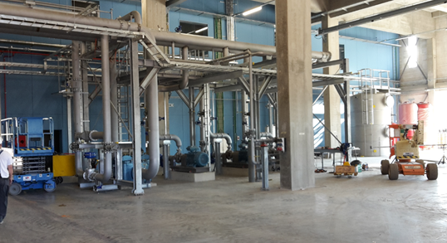
Geothermal (plant) development and start of operation
The balmatt-project
Heat delivery to VITO-SCK domain
Electricity production using flexible ORC-installation from Atlas-Copco

Slide 4
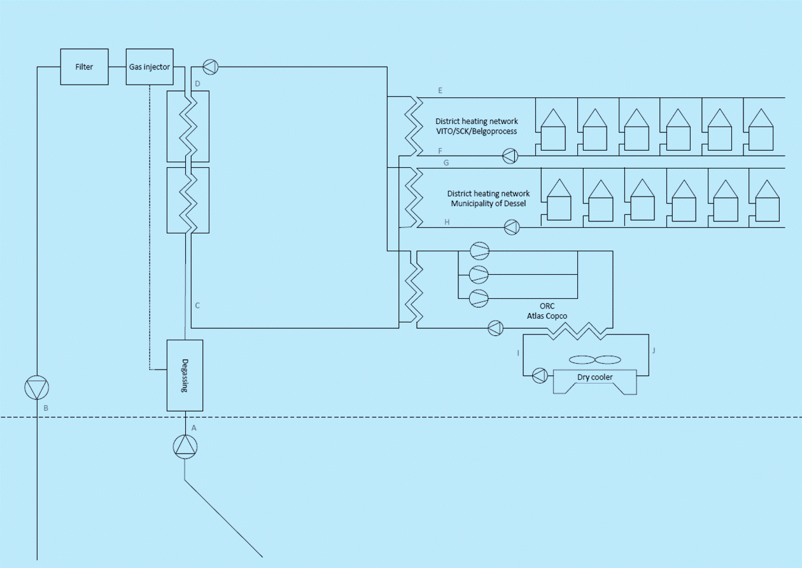
Innovations: H2020-project proposal GeoSmart
The Balmatt- project

Slide 5
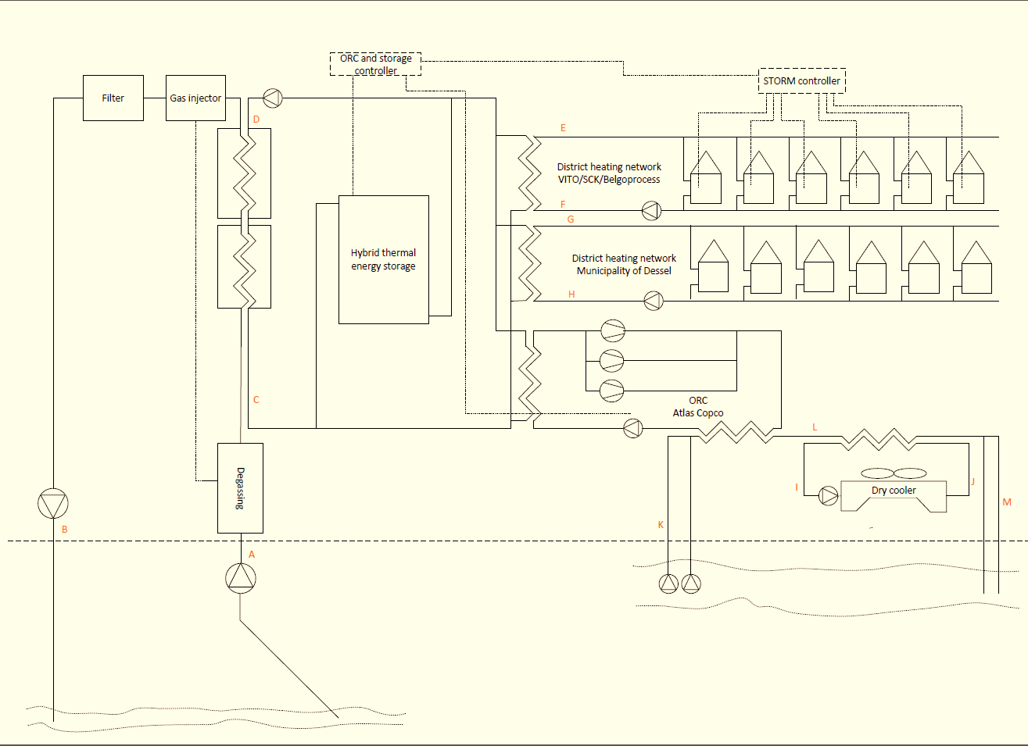
Innovations: H2020-project proposal GeoSmart
The Balmatt- project

Slide 6
Innovations: H2020-project proposal GeoSmart
The Balmatt- project

Slide 7
Innovations: H2020-project proposal GeoSmart
The Balmatt- project

Slide 8
Innovations: H2020-project proposal GeoSmart
The Balmatt- project

Slide 9
Innovations: H2020-project proposal GeoSmart
The Balmatt- project

Slide 10
Innovations: H2020-project proposal GeoSmart
The Balmatt- project

Slide 11
Thank you for your attention
The Balmatt- project
For more information:
https://vito.be/en/vito-insights/deep-geothermal-energy
https://vito.be/en/deep-geothermal/balmatt-energy-plant

