Slide 1
Flexires Workshop
The role of ORC towards electricity decarbonisation
Marco Baresi
Institutional Relations & Marketing Director
Brussels, 10th January 2019

Slide 2
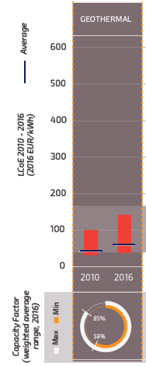
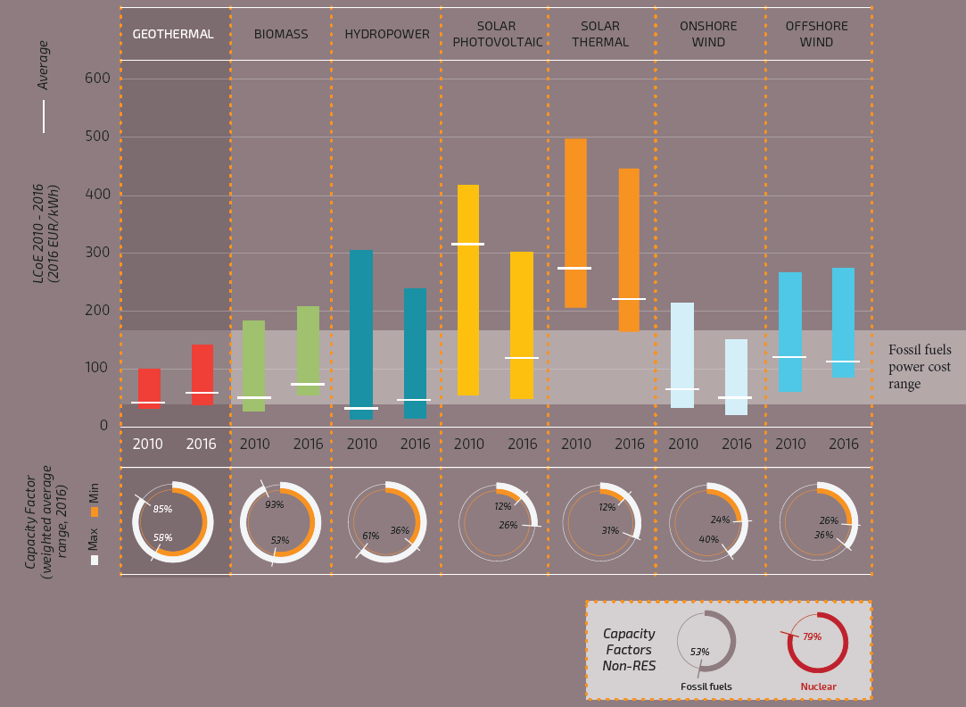
What is geothermal? FIGURES
The Capacity Factor is much higher than for other renewable energy sources
sources: Renewables 2017 Global Status Report, REN21; EUROSTAT.
LCoE comparable or lower than for other energy sources
source: IRENA 2017.

Slide 3
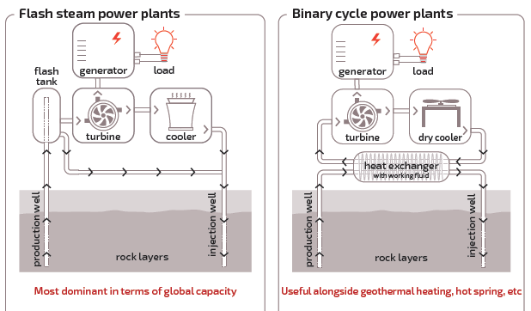
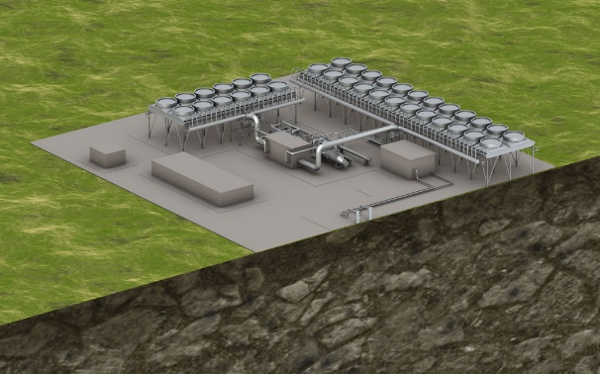
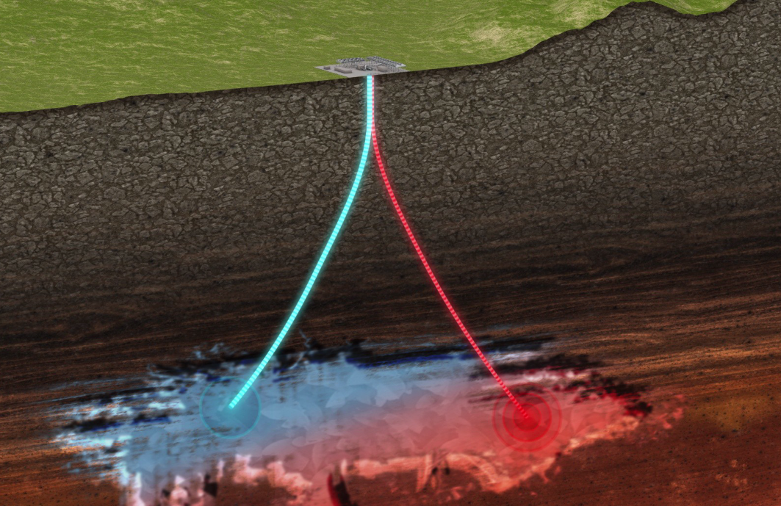
WHAT IS GEOTHERMAL? TECHNOLOGY
The role of ORC towards electricity decarbonisation

Slide 4
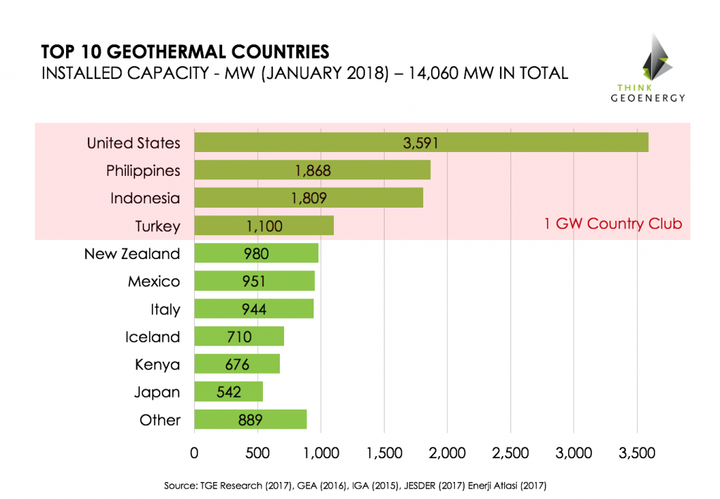
Geothermal worldwide

Slide 5
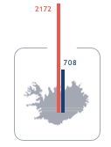
geothermal today in eu
2172
102
POWER PLANTS
280
DISTRICT HEATING
708
7 countries
2,5 GWe
24 countries
44
33
14
2
142
336
64
1131
509
10
38
8
253
872
60
1
13
3
88
160
4
916
20
0.1
source: EGEC market report 2017.
17
DISTRICT HEATING
ELECTRICITY
33

Slide 6
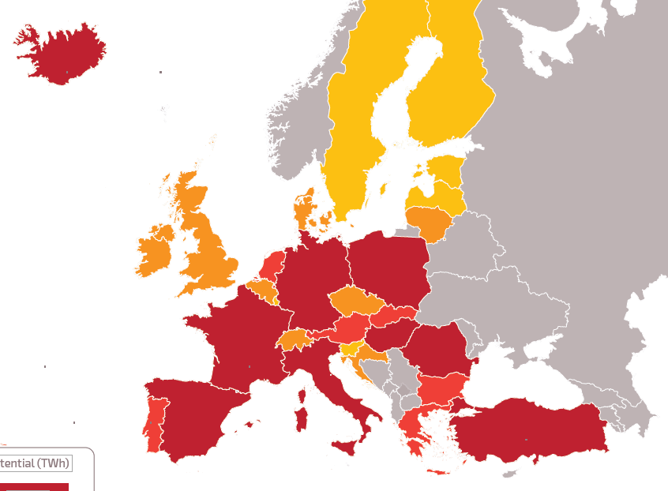
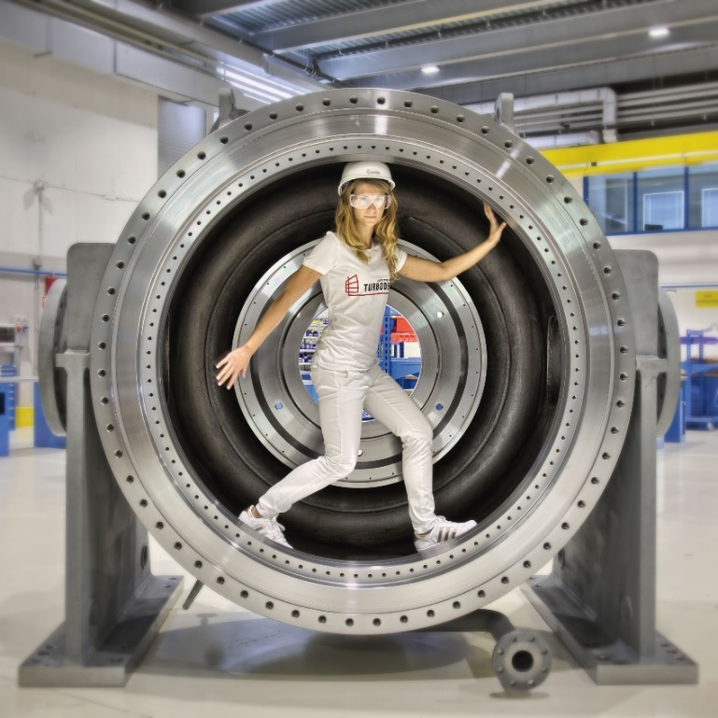
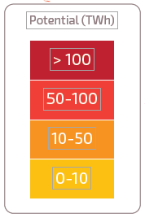
GEOTHERMAL POTENTIAL in eu
> 100
Potential electricity production to 2050
(source: EGEC Market Report 2016.)
…an opportunity for EU ORC (Organic Rankine Cycle) technology leadership
50-100
10-50
0-10

Slide 7
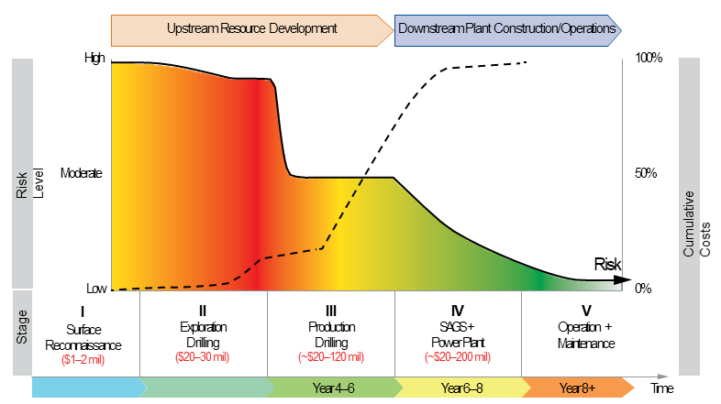
GEOTHERMAL TIMELINE AT A GLANCE
Source: 2016, Esmap (World Bank) Comparative Analysis of Approaches to Geothermal Resource Risk Mitigation.

Slide 8
Role of flexible GEOTHERMAL
The EU internal market has become more complex due to the fundamental change the markets are undergoing in particular regarding deployment of variable renewable electricity production”
[cit. par. 49 draft agreement on electricity market regulation]
 |  |  | S
 |  | P | U |  | F |  |  | S
 | R | R | S |  | L |  |  | T
G | E | O | T | H | E | R | M | A | L
 | S | V | A |  | X |  |  | B
 |  | E | I |  | I |  |  | L
 |  | N | N |  | B |  |  | E
 |  |  | A |  | L
 |  |  | B |  | E
 |  |  | L
 |  |  | E

Slide 9
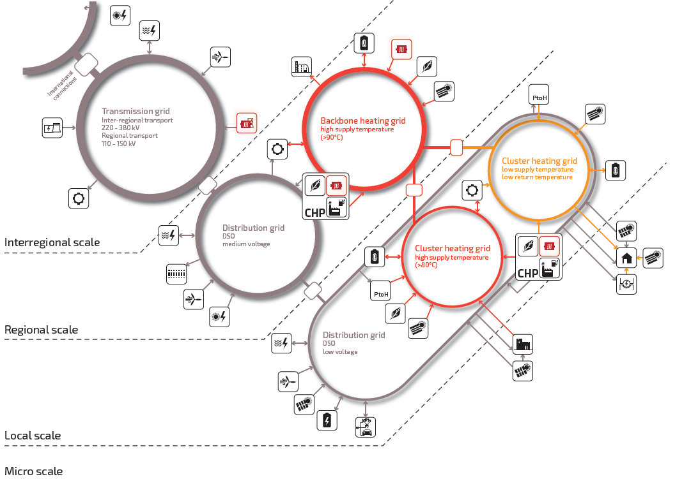
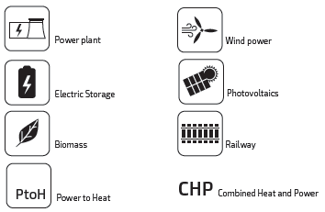
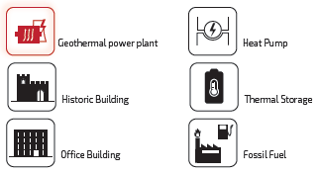
Role of flexible GEOTHERMAL
Source: Vision for deep geothermal 2018.

Slide 10
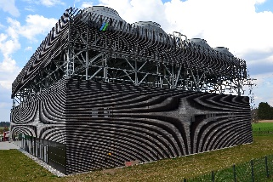
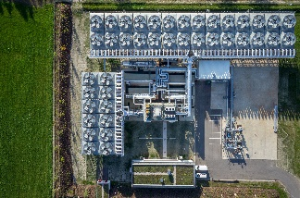
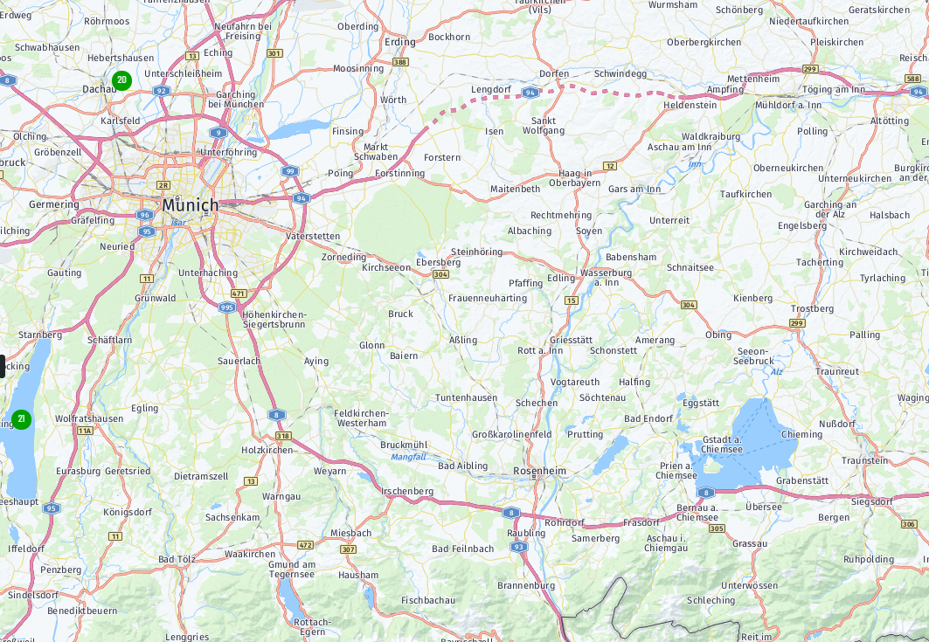
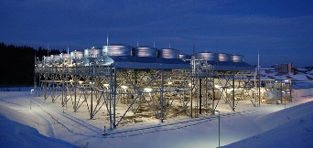
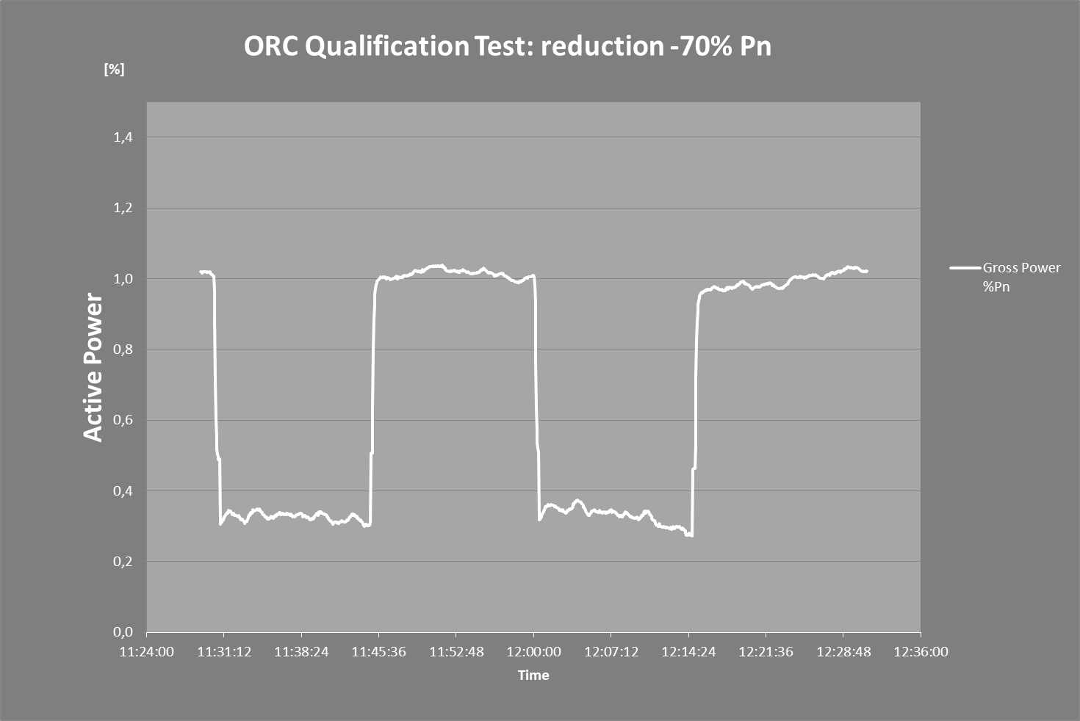
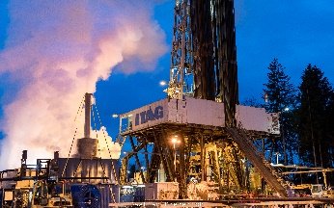
TURBODEN POWER PLANTS IN BAYERN - SWM
The Geothermal Turboden’s ORC Experience in Germany
Power can be reduced from 100% to 30% in <15 seconds
and goes back to 100% in <15 seconds
23 MWe cumulative power production
SAUERLACH
5 MWe + 4 MWth
DÜRRNHAAR
5.6 MWe
KIRCHSTOCKACH
5.6 MWe
1
2
3
TRAUNREUT
4 MWe + 12 MWth
4
HOLZKIRCHEN
(Start-up Q1 2019)
3 MWe + 10 MWth
3
1
2
5
4
5
26 MWth
cumulative
heat
production
The role of ORC towards electricity decarbonisation
Notes:
The next example I wanted to report are our binary geotermal power plants in the bavaian área (close to Munich in Germany).
The geothermy conditions in this área are challenging, the geo reservoir is about 3 miles deep, the temperatura of the hot wáter is pretty low (between 250 F and 285 F).
In the last few years we installed 4 power plants, of around 5 MW each.
In total the power plants generates around 20 MW of electricity sent to the grid and around 55 MMBtu/h of termal power (hot wáter) for district heating.

