Slide 1
Flexible Renewables in the Electricity System
Dr.-Ing. C. Wieland
Sebastian Eyerer, M.Sc.
Prof. Dr.-Ing. H. Spliethoff
Technische Universität München
Fakultät für Maschinenwesen
Lehrstuhl für Energiesysteme
Brussels, 10. January 2019

Slide 2
Outline
User Behaviour
Control Power as Such
Key Issues Learned From Germany
Examples of Suitable Technologies
Sustainability in Energy Transition

Slide 3
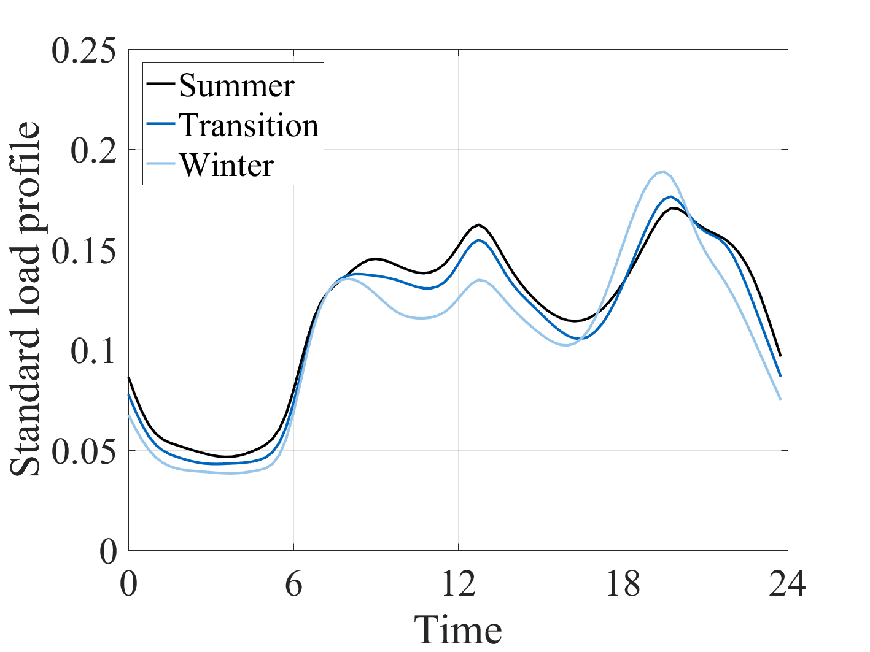
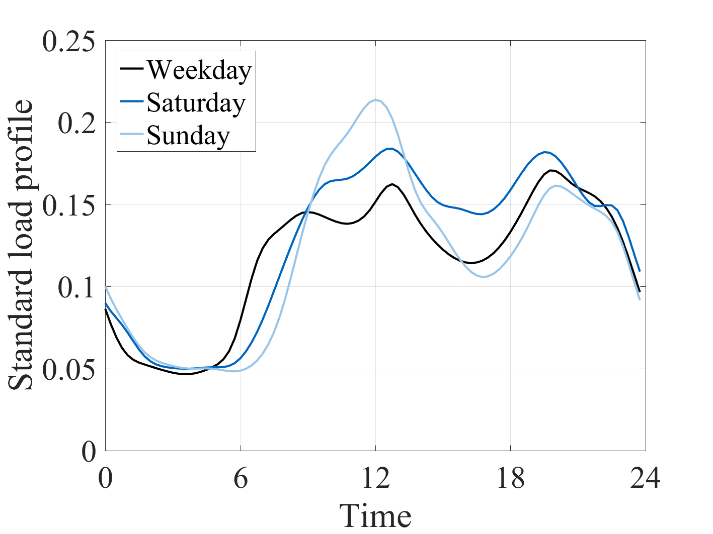
1. Electricity demand of individual households
Load/demand is fluctuating depending on user behavior
Standard load profiles are derived, somehow approximate or forecast the demand
Stochastic user behavior is superpositioned

Slide 4
Electricity demand depends on weather and user behavior.

Slide 5
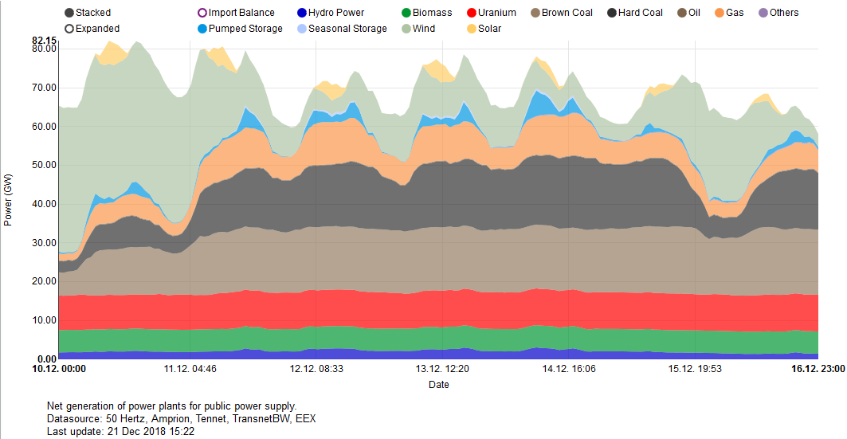
1. Electricity demand in Germany
Source: https://www.energy-charts.de/power.htm
Wind varies significantly, solar has low contributions, coal and gas are enabling integration
Daily fluctuations

Slide 6
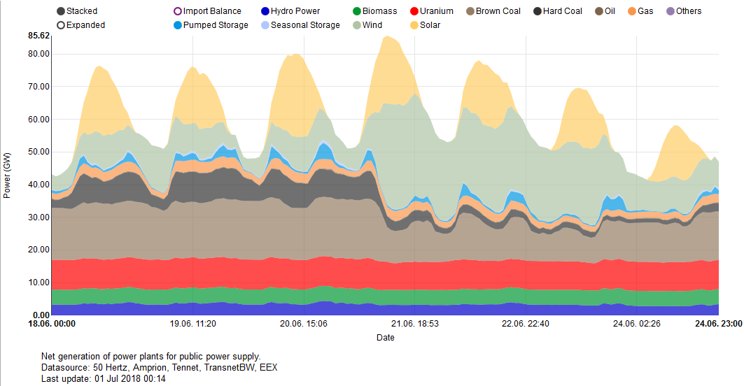
1. Electricity demand in Germany
Source: https://www.energy-charts.de/power.htm
Wind and solar vary significantly, coal and gas are enabling integration
Up to two significant fluctuations per day, due to high solar share

Slide 7
Electricity production needs to fulfil the demand at any time.

Slide 8
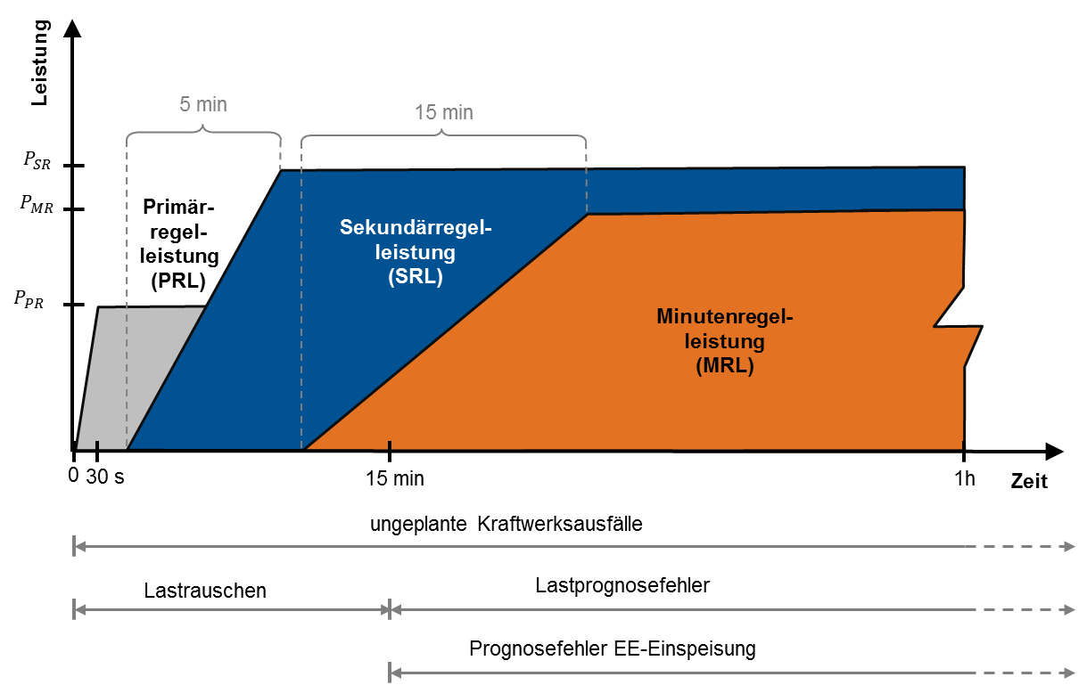
2. Types of control power
Power
Primary control power
Secondary control power
Minute reserve power
Time
Source: [1]
Unscheduled power plant outages
Load fluctuations
Forecasting errors of load
Forecasting errors of renewable energy production

Slide 9
Control power can be purchased on markets, provided by power plants

Slide 10




3. Local Imbalances I
National imbalances between supply and demand (Wind: North, Demand: South)
Electricity grid limitations cause electricity flow through grids in neighboring countries
Frequent frauds cause „protectionism“ by installation of quadrature boosters/phase shifters

Slide 11
3. Local Imbalances II
National imbalances between supply and demand (Wind: North, Demand: South)
Wind plants are curtailed and fossil reserve power is activated.
Double costs for wasted RES and redispatched (fossil) reserve power

Slide 12
3. No Wind (and no PV)
Low wind conditions lead to shortage in power supply
Reduced (fossil) generation capacity cannot fully compensate
Neighboring countries need to provide electricity with their generation capacity

Slide 13
We need (1) more local renewable and dispatchable capacities and (2) to generate local microgrids

Slide 14
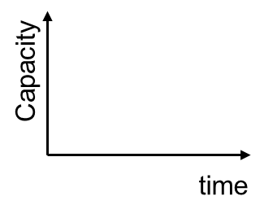

4. Example: Biomass
Source: adapted from [2] and [3]
Increasing ICEngine and/or Biogas tank for enabling flexibility potential

Slide 15
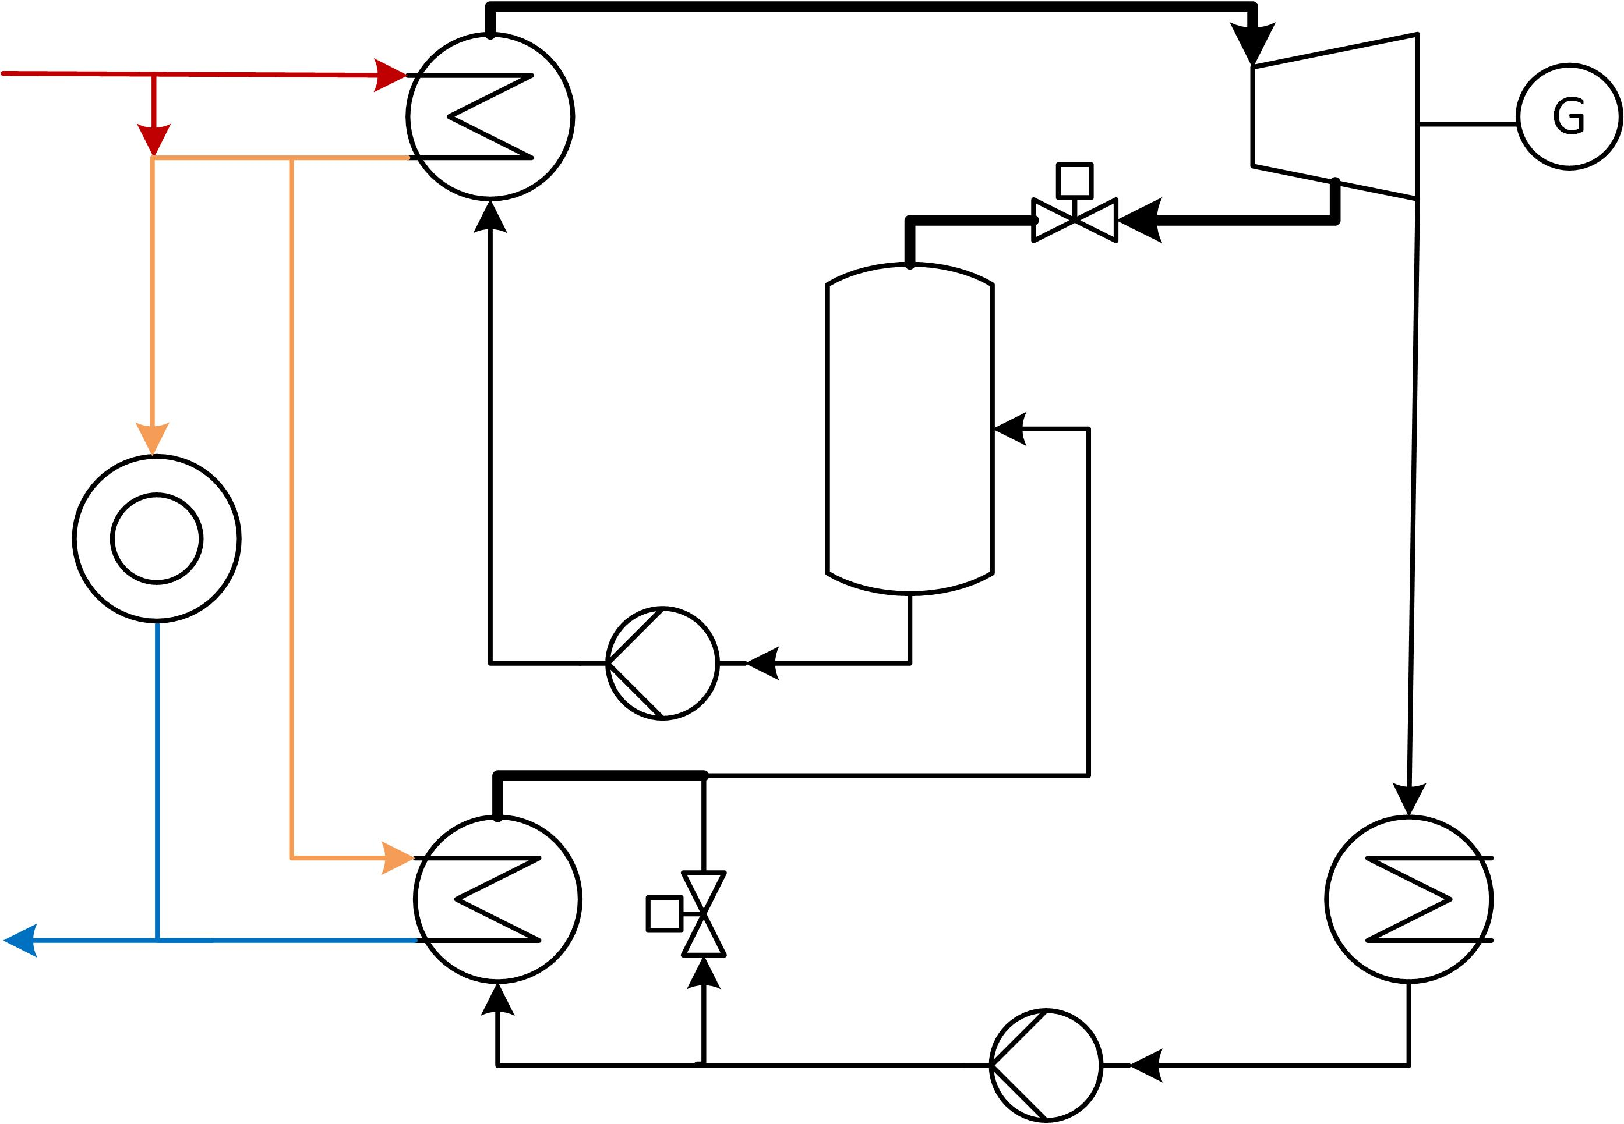
4. Example: Geothermal CHP
Source: [4]

Slide 16




4. Example: Geothermal CHP
Industrial waste heat
Heat pumps
Power-to-heat
Heat storage
Source: [4]
Increasing the flexibility of renewable CHP technology for enabling flexibility potential

Slide 17
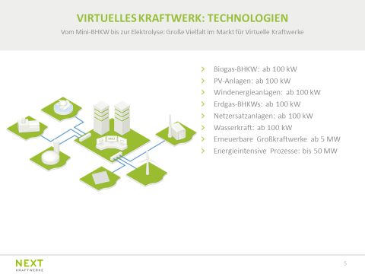
4. Example: Aggregators (e.g. Next Kraftwerke)
Biogas CHP
PV Systems
Wind power plants
Natural gas CHP
Dispatchable plants
Hydro plants
Large scale renewable plants
Energy intesive industry
Source: [5]

Slide 18
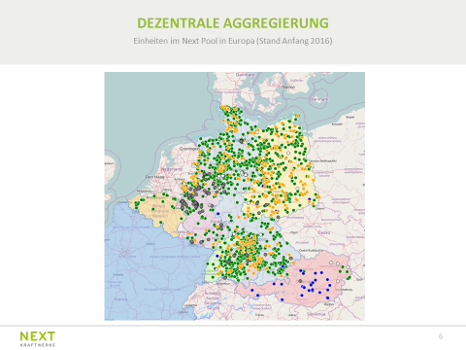
4. Example: Aggregators (e.g. Next Kraftwerke)
Pooling generation capacity
Placing control power on markets
Restrictions for market access in Germany:
  5 MW (until 2018)
  1 MW (from 2018)
  What‘s up next?
Source: [5]

Slide 19
5. Costs vs. Sustainability
Triple-Bottom-Line
Each section is treated equally and of same importance.
Priority Modell
Sections will be prioritized with increased importance
Social
Environmental
Financial
Environ-mental
Social
Financial

Slide 20
We need to reconsider the importance of environmental issues in a sustainable development.

Slide 21
References
[1] Eyerer et al.: Praxisforum Geothermie.Bayern 2017
[2] Schuster et al.: Energetic and economic investigation of Organic Rankine Cycle applications, Applied Thermal Engineering, 29 (2009), pp. 1809–1817
[3] J. Karl, Dezentrale Energiesysteme, Neue Technologien im liberalisierten
Energiemarkt, Oldenbourg Verlag, München, 2004
[4] Dawo: Strom aus Geothermie – Stromwäsche oder reales Potential?, Seminarvortrag, Lehrstuhl für Energiesysteme, 19.10.2018
[5] Aengenvoort: Next Kraftwerke – Intelligente Kombination Erneuerbarer/Konventioneller Technik / Insellösungen, Vortragsreihe des VDI-AK Energietechnik und des Lehrstuhls für Energiesysteme, München, 14.03.2016

Slide 22
Flexible Renewables in the Electricity System
Dr.-Ing. C. Wieland
Sebastian Eyerer, M.Sc.
Prof. Dr.-Ing. H. Spliethoff
Technische Universität München
Fakultät für Maschinenwesen
Lehrstuhl für Energiesysteme
Brussels, 10. January 2019

Slide 23
Back-Up RE Costs

